Slide 1

My House
Rooms, objects, “there is/are”

Slide 2
Vocabulary
Dear student, please go to this Youtube video: https://www.youtube.com/watch?v=R9intHqlzhc
and learn the new words! You can do it! ☺

Slide 3
Vocabulary exercise
What do you see? Write your answer in your English notebook. Every sentence should start with: “This is a/an ____________”.
For example: “This is a toilet.

Slide 4
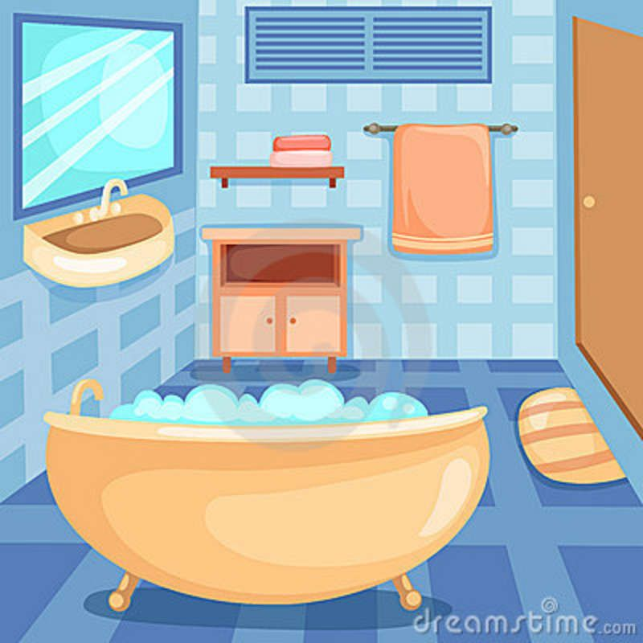
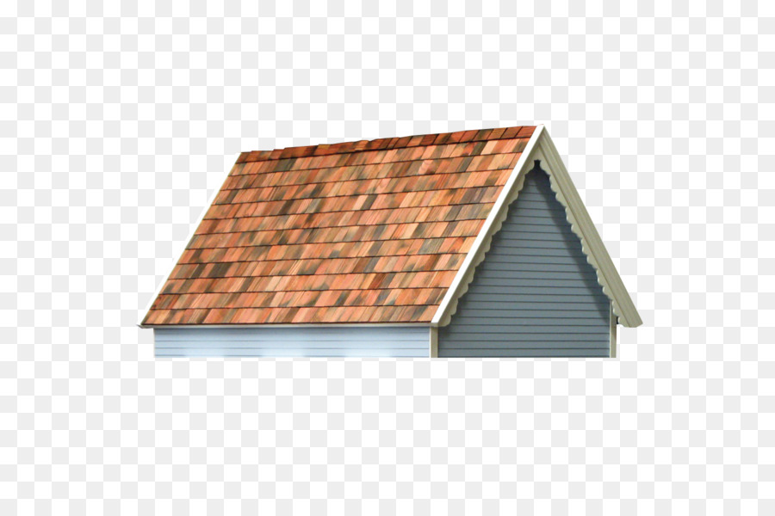


Slide 5
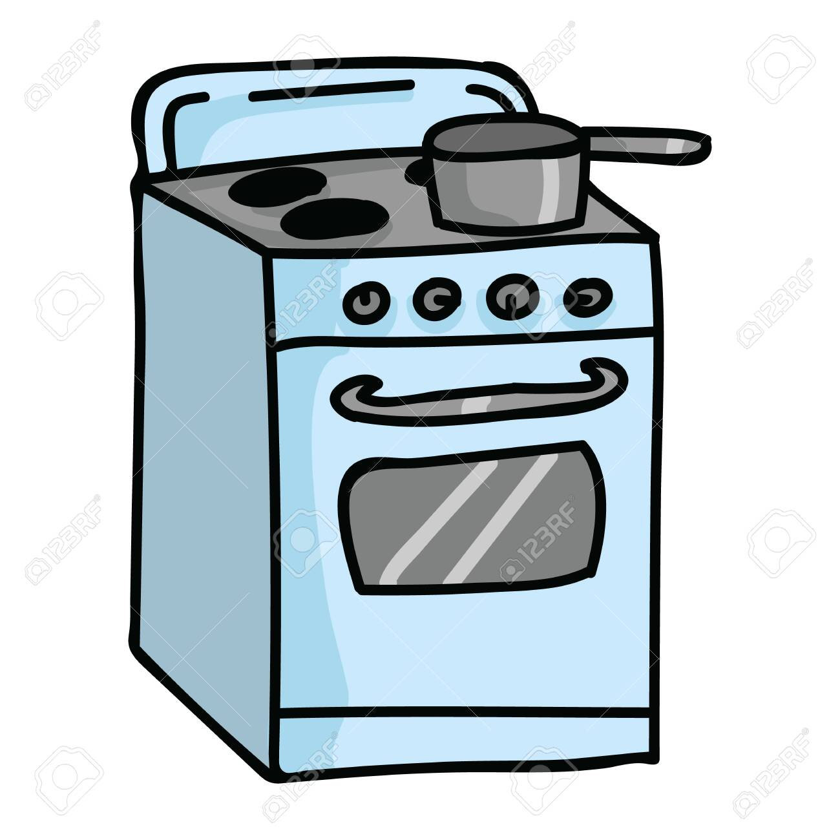
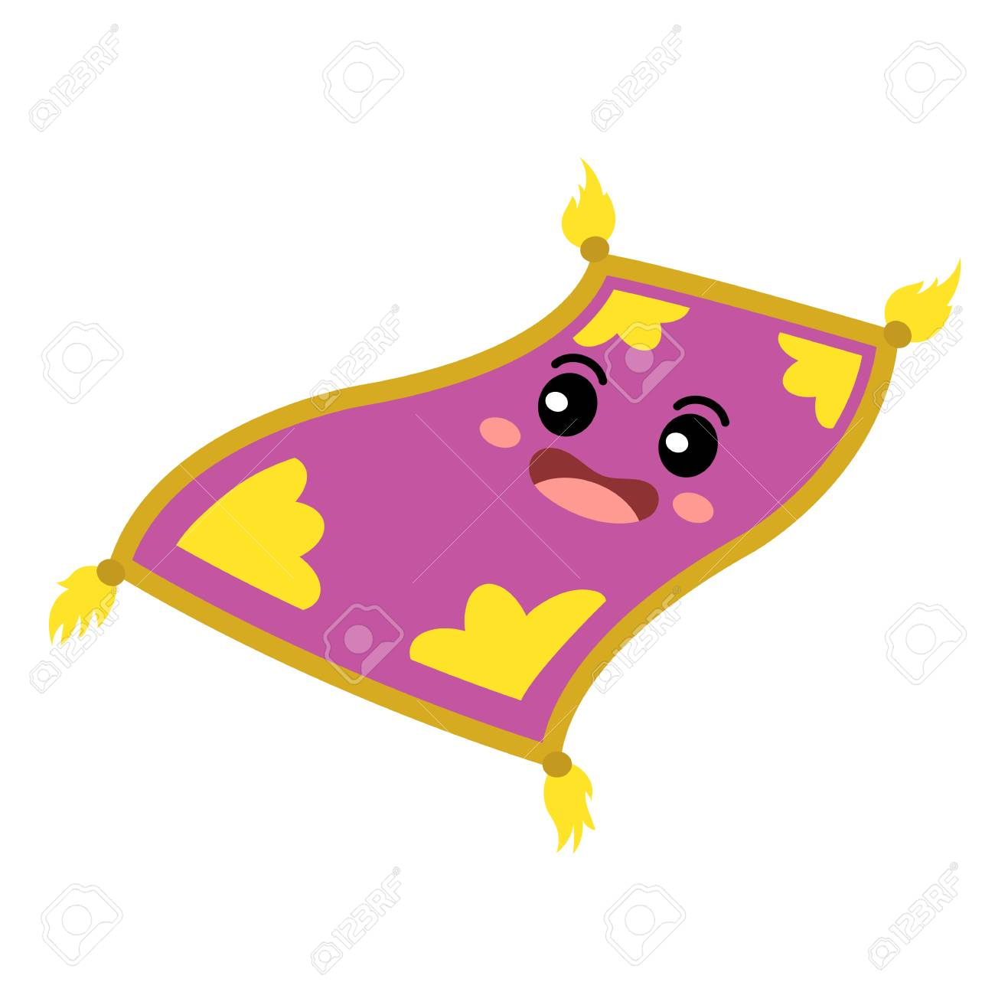
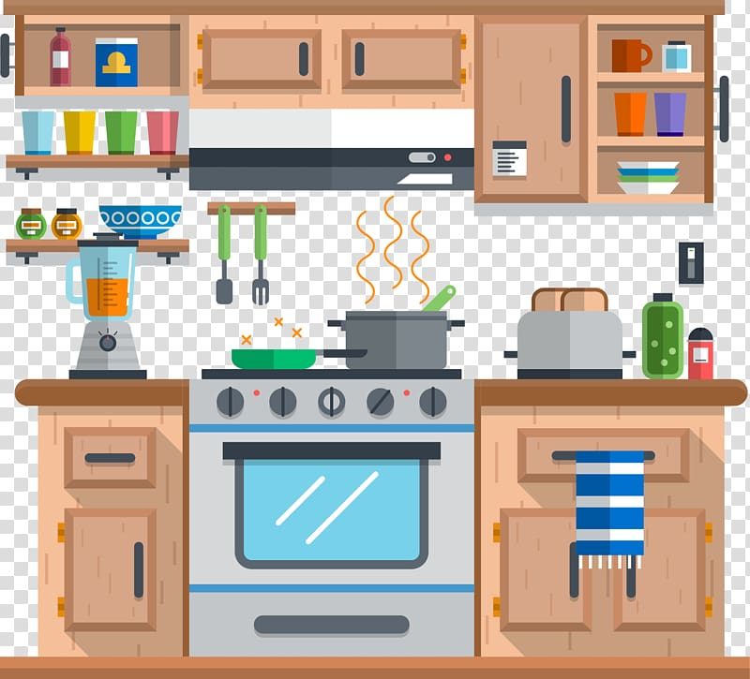

Slide 6
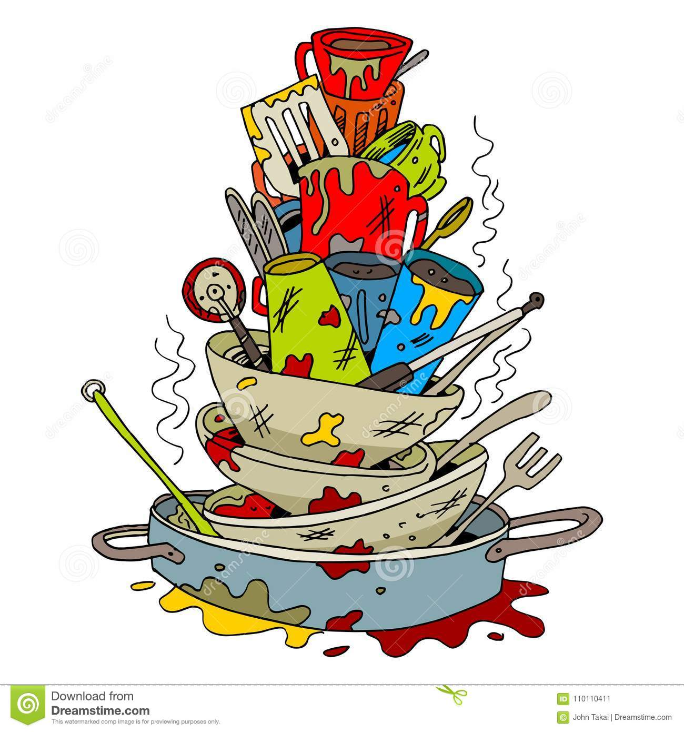
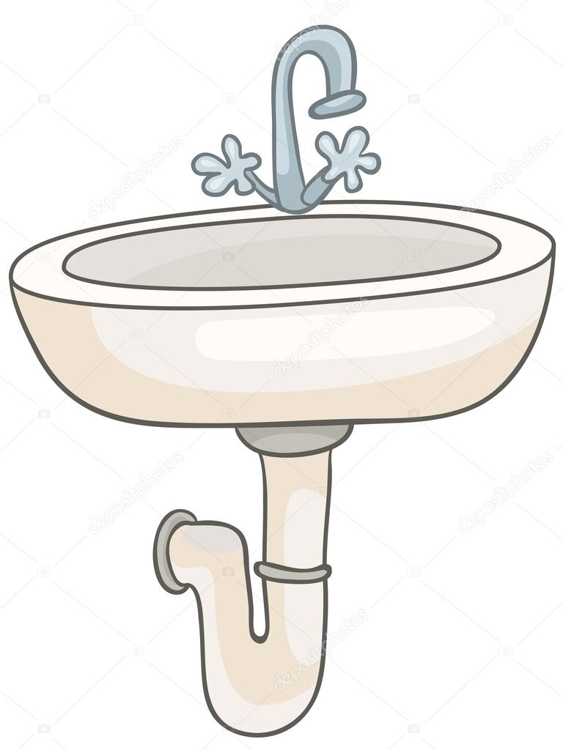


Slide 7
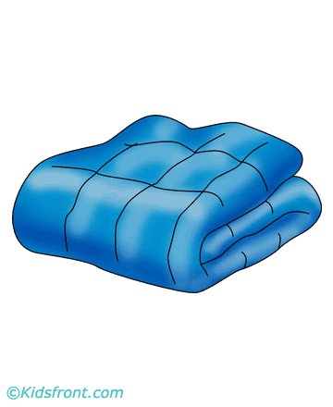


Slide 8
There is / There are
У којим ситуацијама користимо ове две фразе?

Slide 9
There is / There are користимо…
…када желимо да кажемо да се нешто негде налази.
Нпр: There is a sink in the bathroom. (У купатилу се налази лавабо.)

Slide 10
There is(1 thing) | a book an apple | There is a book on the table. There is an apple on the table.
There are(2+ things) | 2 books apples | There are 2 books on the table. There are apples on the table.

Slide 11
Is there(1 thing) | a book | Is there a book on the table?
Are there (2+ things) | apples | Are there apples on the table?

Slide 12
Extra explanation
Dear student, watch this video https://www.youtube.com/watch?v=qPgEaPBSjLM&list=PLSOgrsyzaoExWoaeLXFzAfUsDxWw9uzgW&index=35&t=0s for a more detailed explanation of there is/there are!

Slide 13
Homework
Describe your home (what rooms you have got, what objects there are in the rooms). Do it in your notebook.
(Опиши свој дом; које собе имаш и шта се у њима налази. Домаћи уради у свесци.)

Slide 14
Еxample

Slide 15
Stay safe!

